Slide 1



GENERATING A NARRATIVE BY GIVING PROMPTS TO PRE-TRAINED MODELS WITH EXCELLENT STORY TELLING CAPABILITIES
MOHAMMED AAMER (Student ID: PN1130101) Final Thesis Presentation Master of Science in DATA SCIENCE SEPTEMBER 2024

Slide 2

Research Questions
Adapting fine-tuning techniques to prompt-based learning
Potential of advanced models like GPT-3
Generating coherent narratives without extensive training

Slide 3

Goals and Objectives
Investigate prompt-based learning for narrative creation
Comprehensive literature review
Develop a practical story creation procedure
Evaluate generated stories using automated metrics

Slide 4

Importance of the Research
Addressing the gap in long-form story generation
Supporting writers with AI assistance
Generating new ideas and overcoming writer’s block

Slide 5

Scope of the Research
Experimentation utilizing available software and resources
Relying on automated metrics for evaluation

Slide 6
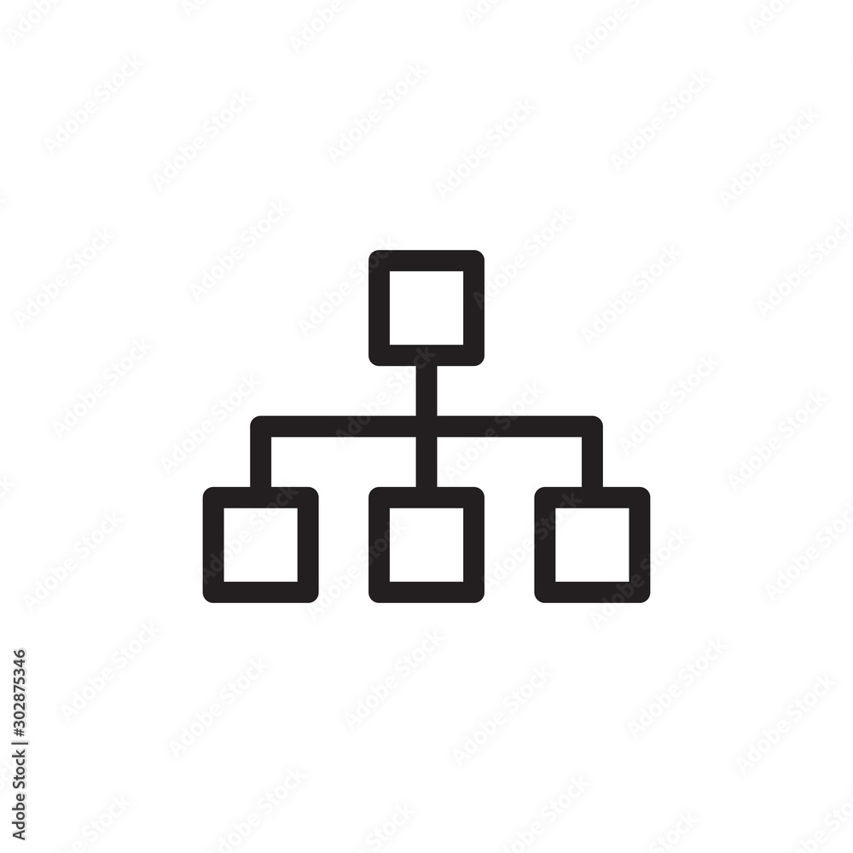
Organization of the Study
Introduction
Literature Review
Methodology
Implementation
Results
Conclusion

Slide 7

Literature Review Overview
Examining existing research in automatic story generation
Highlighting key methodologies and identifying gaps
Contextualizing current research within the broader landscape

Slide 8

Automatic Story Generation
True creativity in storytelling
Character motivations and interactions
Classifying story generation systems

Slide 9
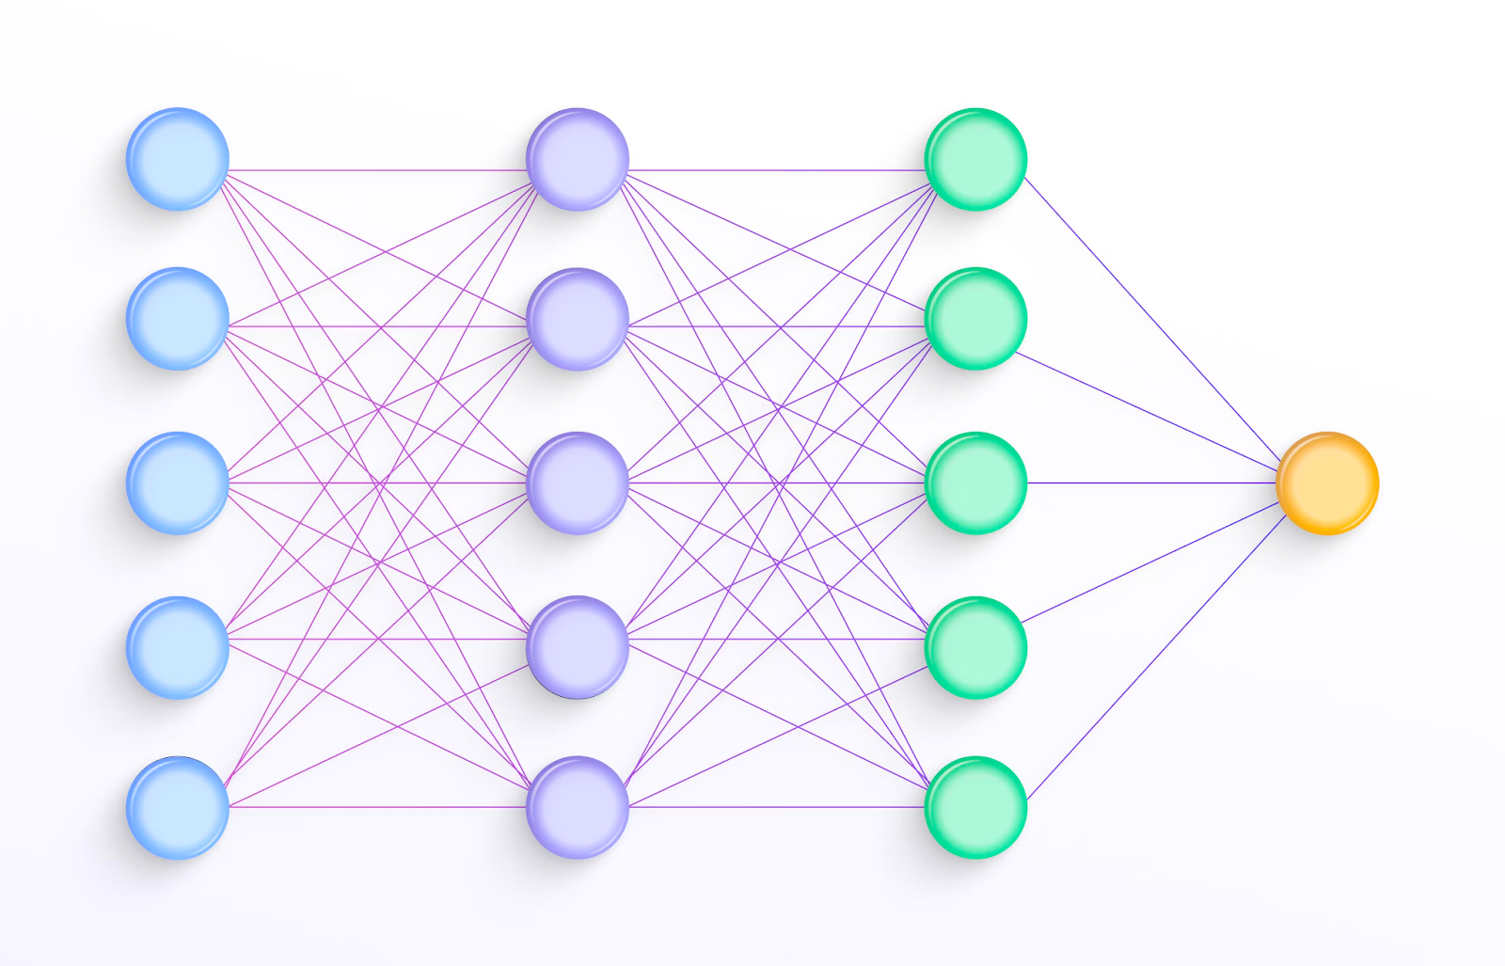
Structural Models
Story graphs and schemas
Limitations in coherence and complexity
Example: SCHEHERAZADE

Slide 10
Planning-Based Models
Critique of traditional story grammar theories
Introduction of story points theory
Focus on causally connected events

Slide 11
Machine Learning Models
Advancements in machine learning approaches
Techniques: story abstraction, script learning, story completion
Impact on automatic story generation

Slide 12
Challenges in Automatic Story Generation
Need for originality and coherence
Effective evaluation metrics
Addressing ongoing challenges

Slide 13
Problem Statement
Difficulty in achieving controlled story generation
Challenges of repetitive narratives
Investigating prompt-based learning as a solution

Slide 14

Methodology Overview
Research methodology employed
Algorithms and techniques used
Data preparation process and evaluation methods

Slide 15
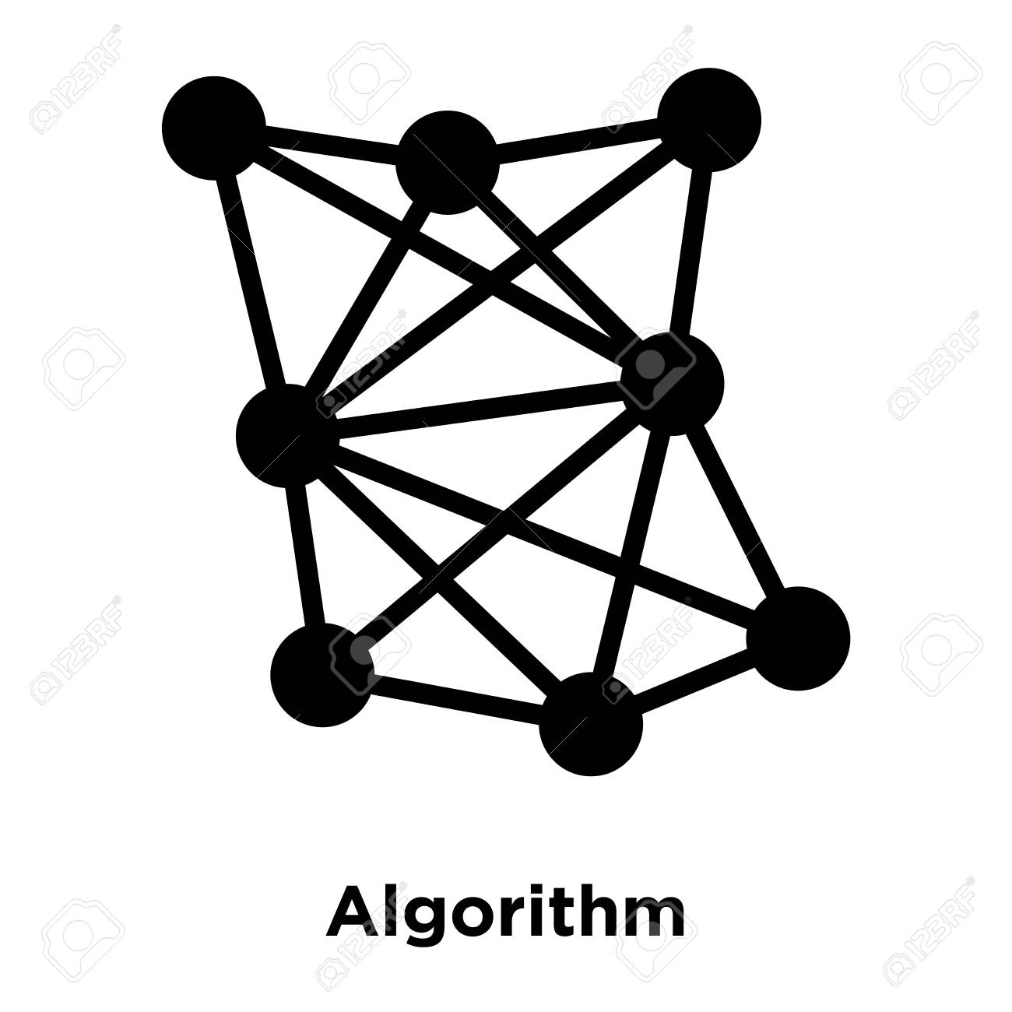
Algorithms and Techniques
Pre-trained language models (GPT-2, GPT-3, etc.)
Applicability in story generation
Characteristics and capabilities of these models

Slide 16

Data Preparation Process
Datasets used (ROCStories, WritingPrompts)
Creating prompts from outlines
Leveraging prompt-based learning for story generation

Slide 17

Evaluation
Evaluation metrics for assessing quality
Quantitative and qualitative measures
Importance of effective evaluation

Slide 18

Results & Discussion Overview
Presenting findings from the study
Quantitative and qualitative analyses
Successes and limitations of the approach

Slide 19

Quantitative Analysis
Evaluation scores obtained using automated metrics
Comparison across different models and prompting techniques
Data-driven assessment of effectiveness

Slide 20
Qualitative Analysis
Examples of generated stories
Strengths and weaknesses of the approach
Insights into narrative coherence and engagement

Slide 21
Insights
Implications of the results for future research
Importance of prompt engineering and model selection
Key takeaways from the study

Slide 22
Conclusion and Future Works
Summarizing key findings and significance
Contributions to understanding prompt-based learning
Future directions for research

